Slide 1

School-Based Management:
Lessons from around the World
December 2012
Harry Anthony Patrinos
Sector Manager
World Bank

Slide 2
Main Messages
Improved school management leads to better schooling outcomes:
  Implies better use of resources (inputs) to produce better results (outputs)
Experience shows parental participation, bonus pay, information can help improve learning outcomes
Need to evaluate to find successful approaches

Slide 3
First, an introduction to cost-benefit analysis

Slide 4
Education
A fundamental right
Contributes to development – economic and social
Leads to technological advance
Makes citizens happier and more productive

Slide 5
More Schooling, More Earning

Slide 6
Private Benefits are Clear
Undisputable
Universal, global
Explaining behavior
Analyzing distribution effects
But not sufficient for funding policies

Slide 7
Benefits to Society Important for Policy
Narrow social returns
Wider social returns

Slide 8
Add the wider social benefits
(High school completion vs. dropping out)
$192 billion extra income and tax
$58 billion health cost savings
$1.4 billion/year in reduced crime costs
9.2 years longer life expectancy

Slide 9
Preschool benefits
Less grade repetition
High school graduation
Better employment chances
Higher earnings
More taxes
Less crime
Less dependence on public assistance
Lower health costs
More equity

Slide 10
Preschool benefit-cost ratios
Perry Preschool—Benefit to cost ratio = 8
Chicago Child-Parent—Benefit to cost ratio = 7

Slide 11
Consider quality
Measured by outcome (learning), not input (spending)
  A 1% increase in the adult literacy skill raises productivity by 2.5% in OECD countries
  An increase in test scores associated with a higher national economic growth rate
  An increase in test scores leads to higher individual earnings

Slide 12
A grand summary
    Preschool
Returns
School
10%
Job training
6
25
Age
Based on Heckman, 2005

Slide 13
Policy implications
Do not fund by inertia
Give priority to funding human capital
Fund quality improvements

Slide 14
But how to use resources more effectively?
That is, how to spend in a way that improves learning by students
Follows are examples from school management literature, based on rigorous impact evaluations from around the world

Slide 15
The Issue
School effectiveness varies
Some schools perform very well; others do not
Why? How do we know? What can we do?

Slide 16

How do we turn this teacher…

Slide 17

… into this teacher?

Slide 18
Improving Education Quality
Education Quality
Poor
Adequate
Good
Great
Drops out
Complaints
Stays
Succeeds
Student Response
Source: McKinsey & Co.

Slide 19
Good to Great through School Management
Poor to adequate | Adequate to good | Good to great
– Incentives – Outcomes – Compensate – Infrastructure – Textbooks – Parental oversight | – Transparency – Decentralizing finance – Parental participation | – Teachers and Principals selection – Professional development – School-based Decision-making – Innovation – Sharing innovation
Source: Adapted from McKinsey and Company (2011); and SABER East Asia

Slide 20
Improved School Management leads to Better Outcomes
Improved school management means more efficient schools; more autonomy; more accountability
Change the environment in which decisions about resource allocation get made
Effective school-level decision making by school-level agents

Slide 21
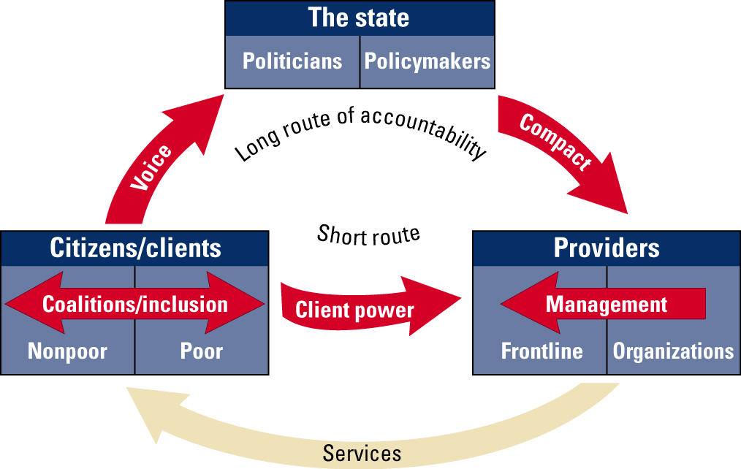
Improving Accountability

Slide 22

School Based Management
Empower parents and hold providers accountable

Slide 23


Main Decision-making Activities
At school level
Budgeting, salaries
Hiring & firing
Curriculum
Infrastructure
School calendar
Monitoring
School grants
Dissemination

Slide 24
School Management Policies to Consider
System Level
Budget planning and approval
Personnel management
Parental participation at school
Assessment of school & student performance
School accountability

Slide 25
How School-Based Management Can Improve Outcomes
Those at local level have better information on:
School personnel
Spending
Resource mobilization
Changes in educational process

Slide 26
Example: Teacher Bonus Pay based on Student Learning, India
Do learning-based teacher bonuses improve student learning?

Slide 27
Teacher Incentives Experiment:
Context & Rationale
Context: poor service delivery quality and learning outcomes
Opportunity: government willing to experiment with innovative potential solutions
Theory of change: Teachers motivated to work harder and focus on student learning results

Slide 28
Teacher Incentive Design: Comparing Alternatives
 | INCENTIVES (Conditional on Improvement in Student Learning)
INPUTS (Unconditional) |  | NONE | GROUP BONUS | INDIVIDUAL BONUS
 | NONE | CONTROL (100 Schools) | 100 Schools | 100 Schools
 | EXTRA CONTRACT TEACHER | 100 Schools
 | EXTRA BLOCK GRANT | 100 Schools
- Bonus formula
  - Rs. 500 bonus ($9) for every 1% point improvement in average scores
  - Calibrated to be around 3% of annual pay (and equal to input treatments)
Source Muralidharan, K. and V. Sundararaman. 2009. “Teacher Performance Pay: Experimental Evidence from India.” National Bureau of Economic Research Working Paper No. 15323. Cambridge, MA.

Slide 29
Summary of Results
Incentive schools performed significantly better, by almost 1 year of learning
Higher levels of teaching activity among teachers at school

Slide 30
Example: Information for Accountability through Report Cards, Pakistan
Does providing information on student and school performance to parents improve student learning?

Slide 31
Information for Accountability: Report Cards
Context: poor and varied learning results, in an active education market
Intervention: provide report cards to parents giving information on child’s and school’s performance
Theory of change: competitive pressure from informed parents can lead to improved quality and/or reduced tuitions in private schools

Slide 32

Report Card Design
Child information | Village Schools Information
Three subjects (Math; Urdu; English) Child score and quintile Child’s School score and quintile Child’s village score and quintile Quintile described as “needing a lot of work” to “very good” | For all Primary schools in villages: School name Number of tested children School scores and quintiles in all 3 subjects
Source: Andrabi, Das, and Khwaja, “Report Cards: The Impact of Providing School and Child Test-scores on Educational Markets” (2009).

Slide 33
Summary of Results
Initially low-quality private schools:
  Increase in learning outcomes, by half a year learning
Initially high-quality private schools:
  Decrease in school fees (by 21 percent)
Public schools:
  Increase in learning outcomes

Slide 34
How School-Based Management Can Improve Outcomes?
More involvement by parents implies accountability by:
Direct involvement of parents in school
Links between parental involvement and decisions
Changes in accounting
Changes in school climate

Slide 35
An Example from Mexico:
Parental Participation
Financial support to Parents Associations
  $600 a year
  Cannot spend money on teacher compensation or hire new teachers; cannot design curriculum
  Mostly spent on infrastructure
  School improvement plan designed by parents
  Revised annually
Parents trained
  Management of the funds
  Participatory skills
  Information on measuring student achievements
  Ways parents can help improve learning

Slide 36
Impact: Reduced Repetition & Failure
Source: Gertler, Patrinos and Rubio 2011

Slide 37
Increased Parental Participation –Most Important Change
Source: Gertler, Patrinos and Rubio 2011

Slide 38
Experiment
Double-grant Group | Schools provided with double the resources
Single grant Group | Schools participating in the program
Training only Group | Schools not participating in the program are provided the training that AGE schools usually receive, but no cash subsidy
Control Group | Not involved in program, no subsidy, no training
Source: Gertler, Patrinos and Rodriguez 2012

Slide 39
Impact 1: Double Grant –
Some Impact
Source: Gertler, Patrinos and Rodriguez 2012

Slide 40
Impact 2: Train Parents Only –
A Lot More Impact
Source: Gertler, Patrinos and Rodriguez 2012

Slide 41
Summary
Doubling cash grant to parents improves learning for young children by 20%
But training parents improves outcomes, even after 1 year implementation, more than impact of doubling grant, over one year of learning
Source: Gertler, Patrinos and Rodriguez 2012

Slide 42
Comparative Costs
(per student)
Parental participation & grant

Slide 43
Autonomy & Accountability
Autonomy: from grants to budgets
Autonomy: from oversight to hiring
Participation: from passive to active parents
Assessment: information, testing, dissemination, use
Accountability: rules/responsibilities, consequences

Slide 44
One key factor: Time to Impact
Evidence from USA
Source: Borman et al (2003), based on 232 studies

Slide 45
Bottom line
School-based management…
Can improve school performance
Inexpensive and cost-effective
But models with low levels of autonomy & limited accountability not likely to produce large gains
Design matters

Slide 46
Bottom line
Use inputs wisely
Trial different approaches, keeping track of progress, comparing before/after, and with/without
Above all, evaluate rigorously, before generalizing
Then expand cost-effective programs

Slide 47
Thank you!
谢谢!

